Slide 1

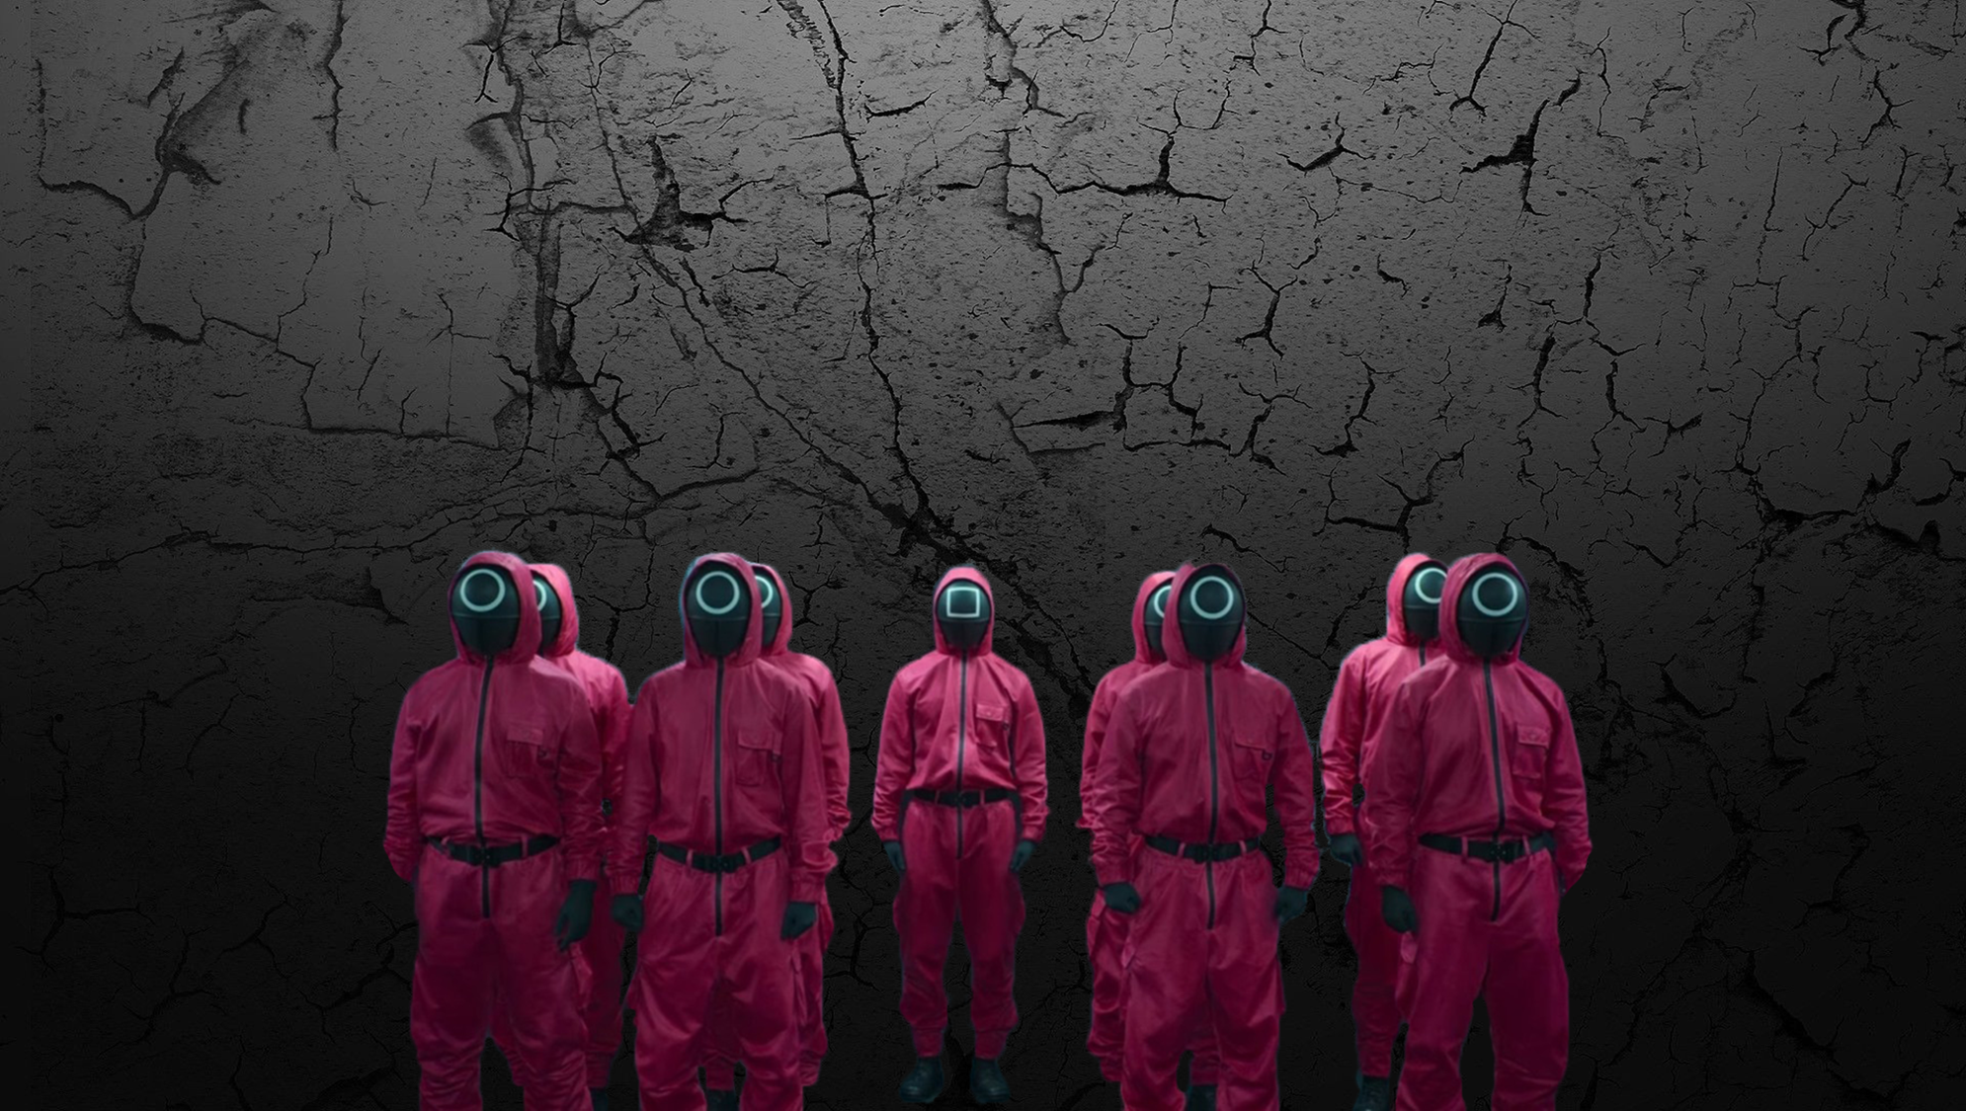
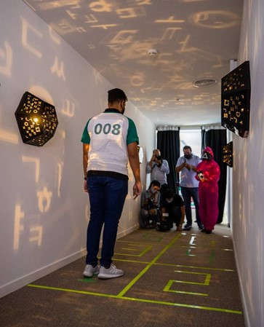

To be successful you'll need to adapt with agility and intelligence.
Key Benefits
Communication skills
Lateral thinking
Time management
Win-win mentality
“Life is like a game, there are many players. If you don’t play with them, they’ll play with you.”
An exciting challenge proving that unity ALWAYS beats division.

Slide 2

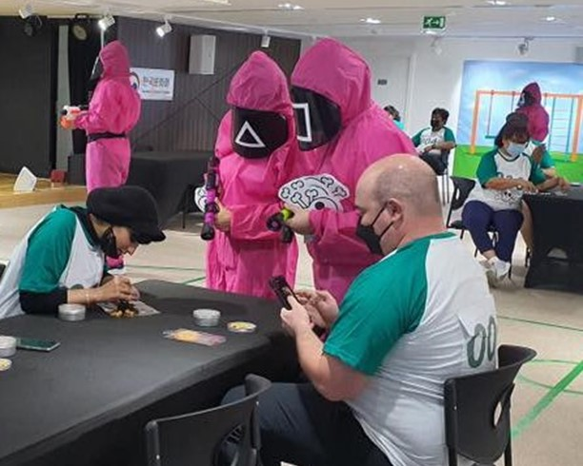



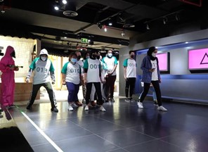
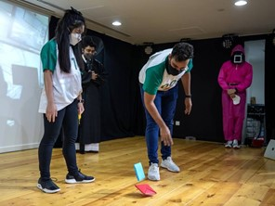
Indoors/outdoors
4 – unlimited
2 hours
Activity Overview
All participants will receive a preliminary teaser with the game symbols and a phone number.
When the participants call the number, they will hear a voice message that provides details of the event and its location.
Every player starts with 100 million points.
There are 6 rounds, each with a different challenge.
The outcome is always binary and absolute; you can either succeed or fail in a round.
Success in a round earns players points.
Fail and you lose points, but it doesn't mean elimination.
The winning Squad will be the team with the most points at the end of the game.
They will be the ones that managed to leverage each other’s strengths best.
As an option we can include a grand finale round whereby the winning compete in a final challenge to determine the overall winner.

